Slide 1
Real-Time Speckle Reduction and Coherence Enhancement in Ultrasound Imaging via Nonlinear Anisotropic Diffusion
Khaled Z. Abd-Elmoniem, Abou-Bakr M. Youssef, and Yasser M. Kadah
2003
Fabian Torres, Imaging Science Club 2012

Slide 2
Abstract
This paper presents a novel approach for speckle reduction and coherence enhancement of ultrasound images based on nonlinear coherent diffusion (NCD) model.
The proposed model combines three different models.

Slide 3
Introduction
A number of methods have been proposed to address the problem of speckle noise.
Averaging and multiframe methods:
Reduce the SNR using uncorrelated images
Simple and fast.
The transducer has to be translated at least by about half its element width for each of the generated frames.
Temporal averaging based on transducer movement causes the loss of small details such as small vessels and texture patterns

Slide 4
Introduction
ASR (adaptive speckle reduction) filtering
Depends on the SNR and the autocorrelation function to permit a varying degree of smoothing according to the extent of the speckle pattern.
This approach works well when applied to the uncompressed backscattered envelope signal.
Inaccurate with the log-compressed signal.
The parameters (such as neighborhood, structure, and speckle thresholds) may not correlate well with actual speckle models.

Slide 5
Introduction
Adaptive weighted median filter
Pixel values are replaced by the weighted median of a local neighborhood whose width is determined based on the SNR around that pixel.
Fine image details are usually lost.

Slide 6
Introduction
Filtering in the wavelet domain
the signal is decomposed in the wavelet domain and the obtained wavelet coefficients are then soft-thresholded.
Feature enhancement was accomplished
High computational complexity and large memory space requirements.

Slide 7
Speckle Model
FFS pattern, which occurs when many fine randomly distributed scattering sites.
Rayleigh distributed
Blood cells
Nonrandomly distributed with long-range order (NRLR) coherent or specular backscattered intensity that is in itself spatially varying.
Nakagami distribution
Lobules in liver parenchyma

Slide 8
Speckle Model
Nonrandomly distributed with short-range order (NRSR) spatially invariant coherent structure is present within the random scatterer region.
Rician distribution
organ surfaces and blood vessels

Slide 9
Lograitmic Compresion
Due to the limited dynamic range of commercial display monitors, ultrasound imaging systems compress the echo signal to fit in the display range, affecting more the high intensities.
As a result, the speckle noise becomes very close to white Gaussian noise. This approach has an advantage in image areas where very few scatterers are present and the SNR is very poor

Slide 10
Diffusion Filtering Models
Isotropic non linear diffusion: Gaussian Filter
Non lineal Anisotropic Diffusion
Mean Curvature Function

Slide 11
Model
This model uses the local coherence to select de diffusion model:
When the coherence is near to 0, the speckle pattern correspond to FFS and should use Isotropic Diffusion.
When the local coherence is ≤ s (stop condition) it corresponds to NRLR speckle pattern and the diffusion should be Anisotropic according with direction and strength.
When the local coherence is > s it corresponds to NRSR and the fiffusion should be selective in countour direction (MCM)

Slide 12
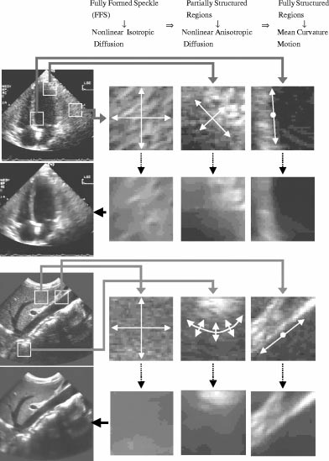

Slide 13
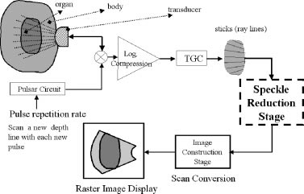

Slide 14
Conclusion
A new nonlinear coherent diffusion model was proposed to reduce ultrasound speckle while preserving the appearance of structured regions and organ surfaces. The new technique has the advantages of robust parameter selection, speed of computation and preservation of texture and organ surfaces. The new technique has a large potential in real-time ultrasound imaging enhancement and in assisting automated segmentation/calculation techniques. 50ms per image.

